Slide 1
Ethiopian Public Health Institute (EPHI)
Data Validation

Slide 2
Outline
Entry level Validation
  Run validation after data entry
  Trend analysis for some consecutive periods.
  Data type check
Rule-based Analysis
  Validation Rules Analysis,
  Standard Deviation Outliers Analysis,
  Min - Max Outliers Analysis
  Follow Up Analysis.

Slide 3
Data Quality
Data is considered high quality when it meets its intended uses, such as operations, decision-making, planning, and response.
Common Data Quality Problems:
  Unusual variations, Duplication of values, Typing errors, Missingness, recording number/date as text, Mismatch of Register, Tally Sheet and Report, etc.
Implications/ risks of Poor Data Quality
  Wrong preparedness and response, incomplete and inconsistent understanding of the situation; Wrong decisions; Poor Planning, Mistrust of data- less use of data, Wastage of Resources,

Slide 4
Data Quality
Solutions: Managing data quality with the dhis2 app and entry stage by running Validation.
  On top of handling organizational and capacity problems, DHIS2 data quality tools help to control or manage the data quality dimensions:
Current-Timeliness: Up-to-date or all data from all reporting organization units should be submitted at the appointed time.
Complete: Data for all data elements for all reporting organization units should have been submitted i.e. Submission by all (most) facilities of the expected reporting sites
  All facilities - all datasets - all fields
Consistent: Data should be consistent with data entered during earlier months and years and consistent with other similar facilities.
  Within normal ranges; with no outlier/ unusual variation.
  comparable across time and other datasets
Correct: Data should be within the normal range for data collected at that facility. There should be no gross discrepancies when compared with data from related data elements.

Slide 5
Data Quality
Data quality verification approaches in DHIS2
At the point of data entry: DHIS2 can check the data entered to see if it falls within the minimum-maximum value ranges of that data element/ data type.
By defining validation rules: which can be run once the user has finished data entry to check whether it is in the defined rule or not.
By analyzing data sets: that is, examine gaps in the data.
By data triangulation: that is, comparing the same data or indicator from different sources.

Slide 6
Validation rule analysis
A method to assess the quality of data entered in dhis2 based on a set of predefined rules set for the data.
This does NOT allow you to Fully assess whether or not reporting number are completely accurate.
Example
A validation rule could assert that "Suspected malaria cases tested" >= "Confirmed malaria cases“;
Total suspected Measles cases >= “0”, etc.…
The validation rule analysis tests validation rules against the data registered in the system.
Violations are reported when the condition defined in rule is not met, which means when the condition is false.
Run the validation rule analysis, either automatically (Scheduler) or manually (Data quality App).

Slide 7
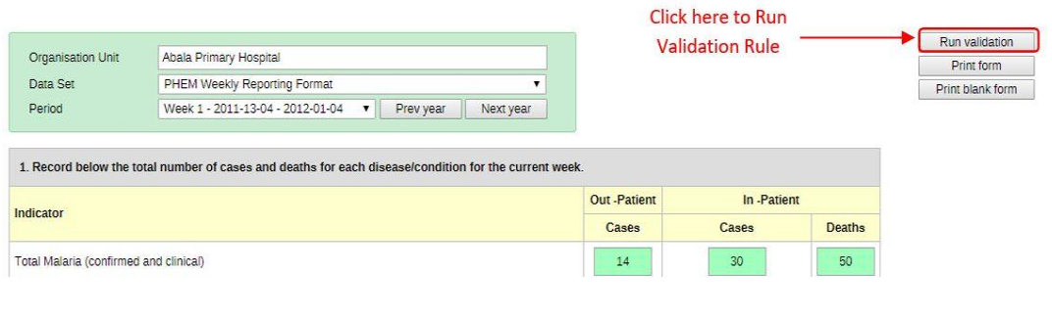
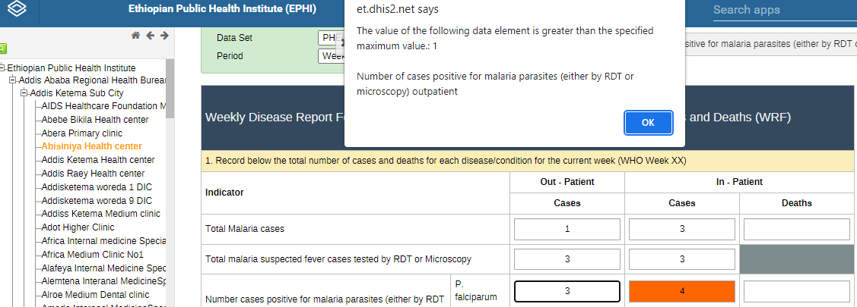
Data quality: Correctiness
Data Entry Level Validations: Data Types, Validation Rules
Used to check Correctiness of the data.
After completing the data entry Run validation rule.

Slide 8
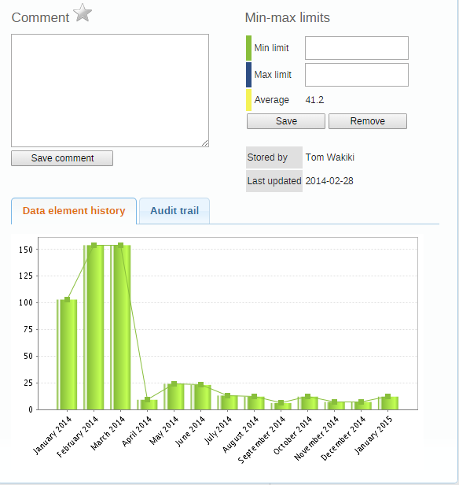
Data Quality: Consistency
Trend Analysis: Trends and Comments for instance
13 consecutive reporting periods.
Used to check Consistency of the data
Create minimum maximum value range manually
Go to Data Entry app, open a data entry form.
Double-click the field for which you want to set the minimum maximum value range
>> Enter Min limit and Max limit >> Click Save
3. (Optional) Type a comment to explain the reason for the discrepancy
4. (Optional) Click Save comment
---help identify outliers[outbreak]/ max-min period / trend

Slide 9
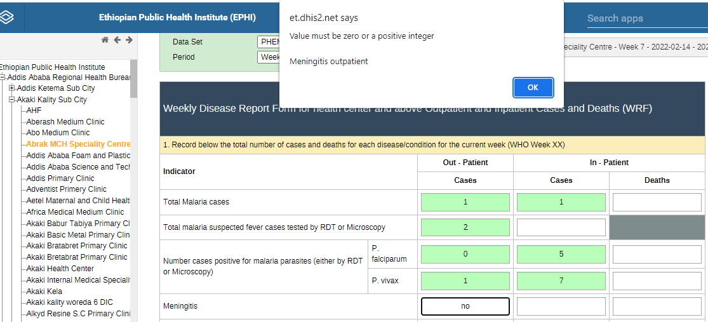
Data Quality: Entry Point
Checking Data type
Most data are Numbers, Text,
Dates, Yes/No or drop-down lists
DHIS 2 has automatic quality
check when mistakes are made.
  By prompting error messages.
Date data elements have
  a date picker
Yes/No and Option Sets have
  drop down lists

Slide 10
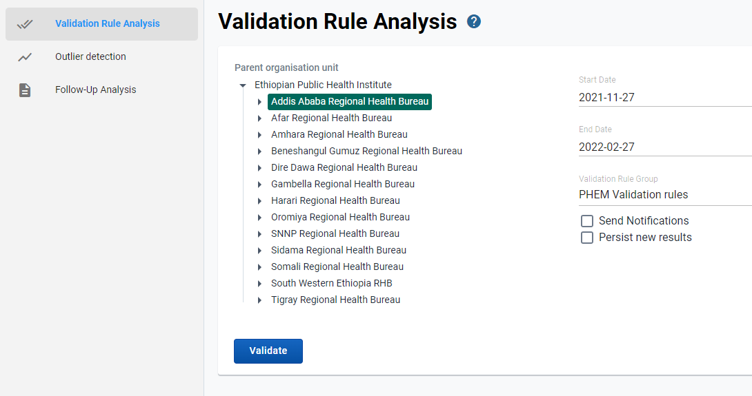
Validation Rule Analysis
This done based on validation rules, validation rule groups and validation notifications created.
Example: A validation rule could assert that “Suspected malaria cases tested” >= “Confirmed malaria cases”.
Steps
Go to Data Quality app and
click Validation rule analysis .
Select Start date and End date
Select which Validation rule group .
Select a Parent organization unit >>
Click Validate >> (Optional) Click
Download as PDF , as Excel or Download as CSV

Slide 11
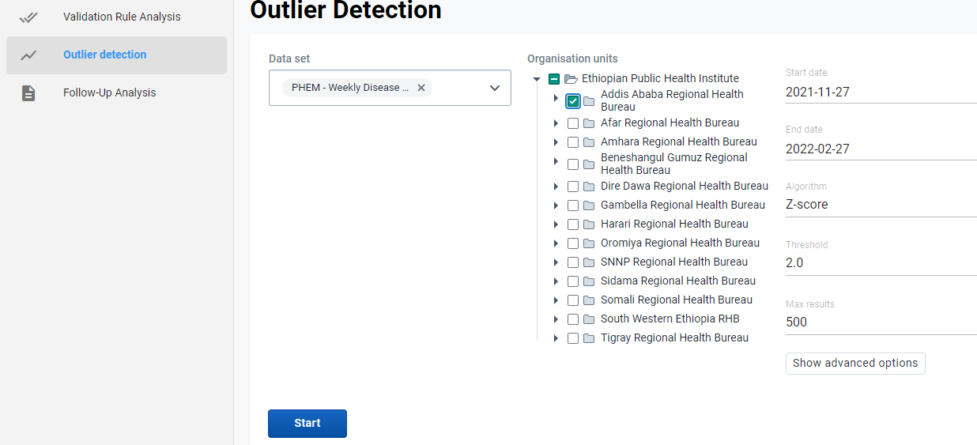

Outlier analysis [Standard Deviation]
The analysis identifies values that are numerically distant from the rest of the data based on the standard normal distribution.
DHIS2 calculates the mean of all values for an organization unit, data element, category option combination and attribute option combination.
Steps
Go to Data Quality app
click Outlier Detection.
Select Start and end date. Select data set(s)
Select Parent organization unit.
Select the number of standard deviations.
Click Start.
If there are standard deviations outliers,
they will be presented in a list

Slide 12
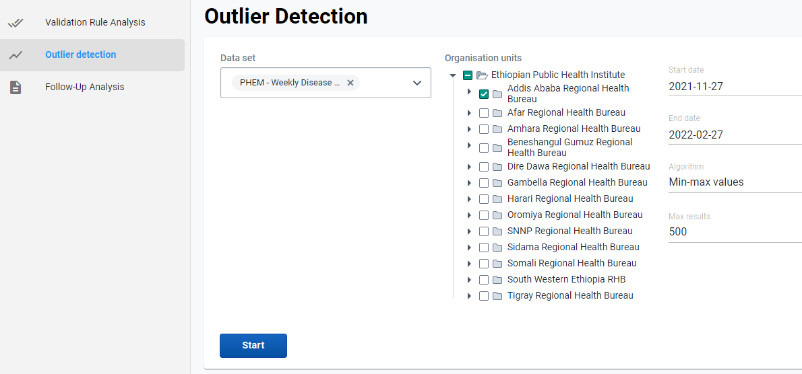
Outlier analysis [Minimum maximum]
This is to verify the data quality at the point of data entry by setting a minimum/maximum value range for data value.
Step:
Verify created minimum maximum value ranges.
Go to Data Quality app
Outlier detection
select Min-max value.
Select start and end date.
Select which data set(s).
Select Parent org. unit.
Click Start.

Slide 13
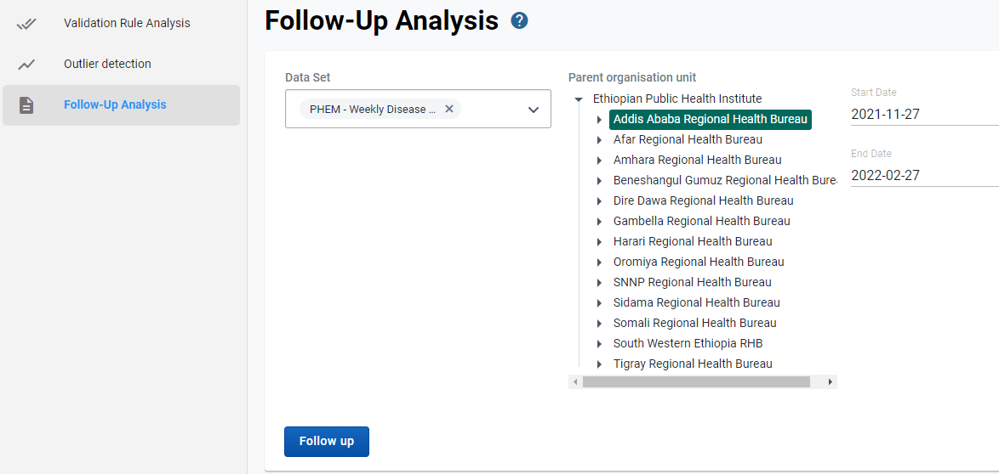
Follow-up analysis
Mark a data element for follow-up
Open the Data Entry app.
Open an existing data entry form.
Double-click the field with the value you want to mark for follow-up
Click the star icon.
Step to conduct FU for marked ones as:
Open the Data Quality app and
click Follow-up analysis .
Select an Organization unit
(Optional) Click Download as PDF ,
Download as Excel or Download as CSV.

Slide 14
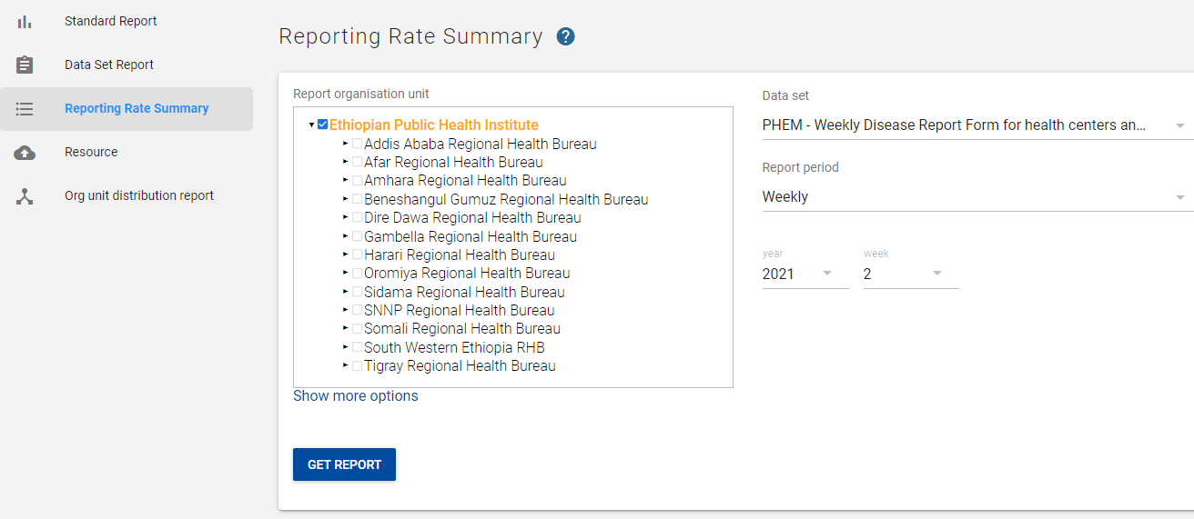
Data Quality: Completeness and Timelines of the data
Reports app: Reporting Rate Summary
To check Completeness and Timelines of the data.
1. Go to Report app
2. select Report rate summary
3. Select Orgunits and Data set
4. Select year and week no
5. Click on Get Report

Slide 15
Thank You

